Slide 1
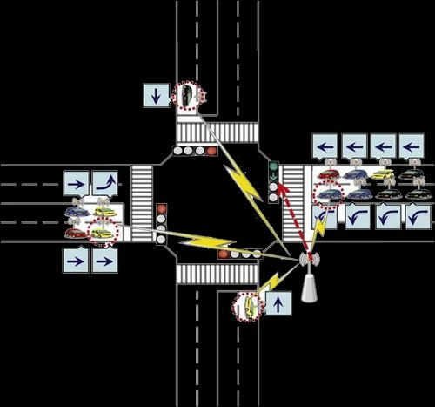
DENSITY-BASED TRAFFIC MANAGEMENT SYSTEM
PRESENTED BY:
MD.AYESHA(20RH1A05E4)
M.MADHU PRIYA(20RH1A05E0)
P.SINDHU(20RH1A05G9)

Slide 2
CONTENTS
PROBLEM STATEMENT
EXISTING SYSTEM
IDEA/SOLUTION
TECHNOLOGY USED
ADVANTAGES
CONCLUSION

Slide 3
PROBLEM STATEMENT
As the problem of urban traffic congestion intensifies, there is a pressing need for the introduction of advanced technology and equipment to improve control over traffic.

Slide 4
EXISTING SYSTEM
We are quite familiar with the manual-based traffic control system which involved the deployment of traffic police at every junction who used to do the signaling sitting in a small hut.
Traffic systems are of three types:
Manually controlled
Volume-based
Time-based traffic control systems.
Since it was a hectic job, so we upgraded ourselves and we have switched to the time-based traffic control system.

Slide 5
IDEA/SOLUTION
The problem with a time-based traffic control system is since it is based upon a pre-determined timing control sequence it fails to handle the dynamic nature of traffic.
So many times it happens that even if there is no traffic still everyone has to wait. They are not flexible according to the traffic intensity.
Due to this a lot of time is wasted and traffic congestion becomes a major issue.
So, the answer to this problem is a volume/density-based traffic control system with IR sensors.

Slide 6
TECHNOLOGY USED
Python
Canny Edge Detection

Slide 7
ADVANTAGES
A system to control the traffic by measuring the real-time vehicle density using canny edge detection with digital image processing.
This imposing traffic control system offers significant improvement in response time, vehicle management, automation, reliability and overall efficiency over the existing systems.

Slide 8
CONCLUSION
The conventional traffic lights use a fixed logic of allocating the same “go time” to lanes at intersections without taking the density of traffic into consideration. But this solution considers the density of traffic and makes necessary changes in the traffic lights, by this congestion is reduced.

Slide 9


